Slide 1
Lecture
Application & Tips:
Learning rate, data preprocessing, overfitting

Slide 2
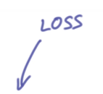
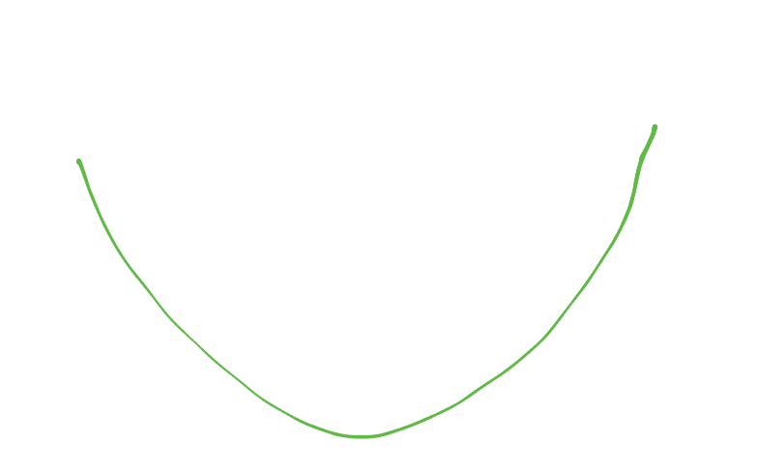
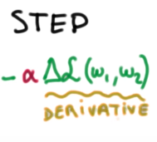
Gradient descent
https://www.udacity.com/course/viewer#!/c-ud730/l-6370362152/m-6379811827

Slide 3
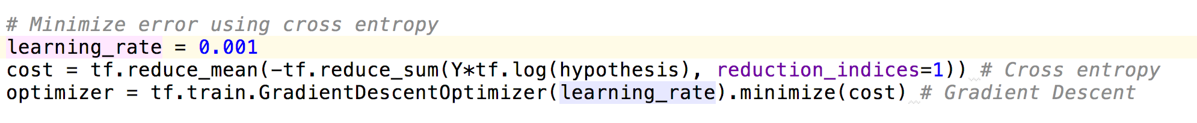
Gradient descent
https://www.udacity.com/course/viewer#!/c-ud730/l-6370362152/m-6379811827

Slide 4
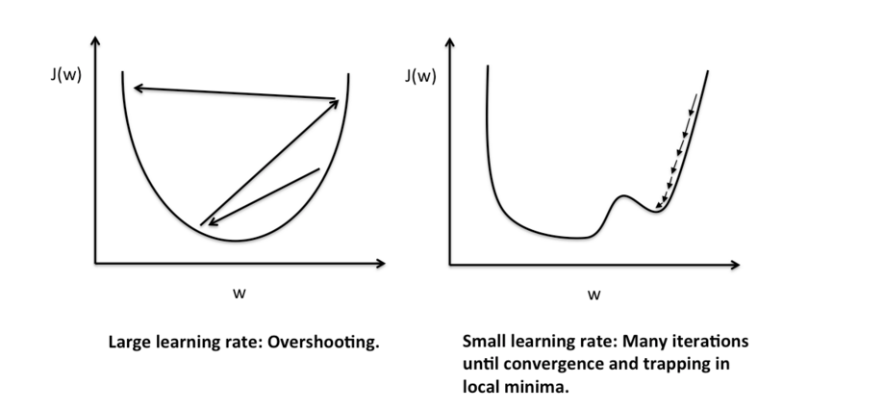
Large learning rate: overshooting
http://sebastianraschka.com/Articles/2015_singlelayer_neurons.html
Notes:
너무 크게 움직여서 수렴이 안됨

Slide 5
Small learning rate:
takes too long, stops at local minimum
http://sebastianraschka.com/Articles/2015_singlelayer_neurons.html
Notes:
너무 작게 움직여서 수렴이 안됨
Learning rate을 정하는데는 답이 없음.

Slide 6
Try several learning rates
Observe the cost function
Check it goes down in a reasonable rate

Slide 7
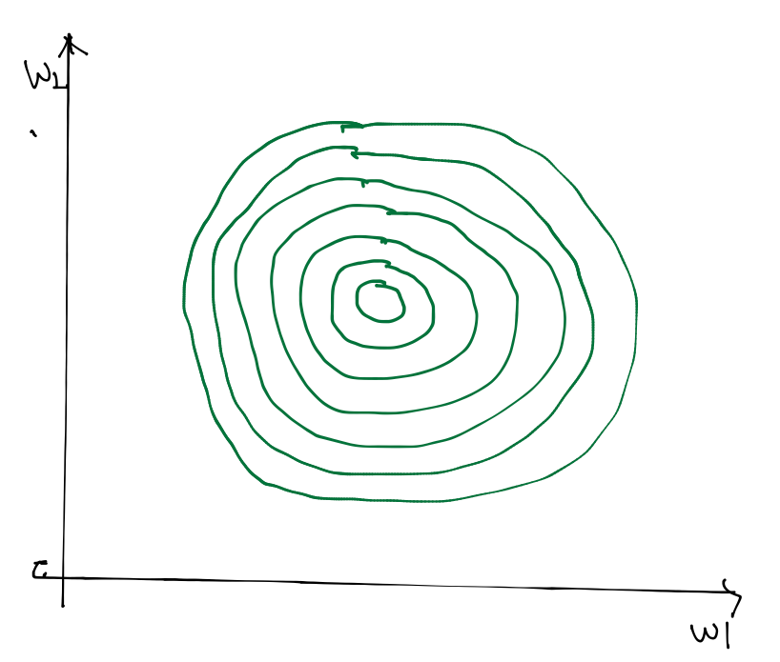
Data (X) preprocessing for gradient descent
Notes:
전처리 해야 될 필요가 있음

Slide 8
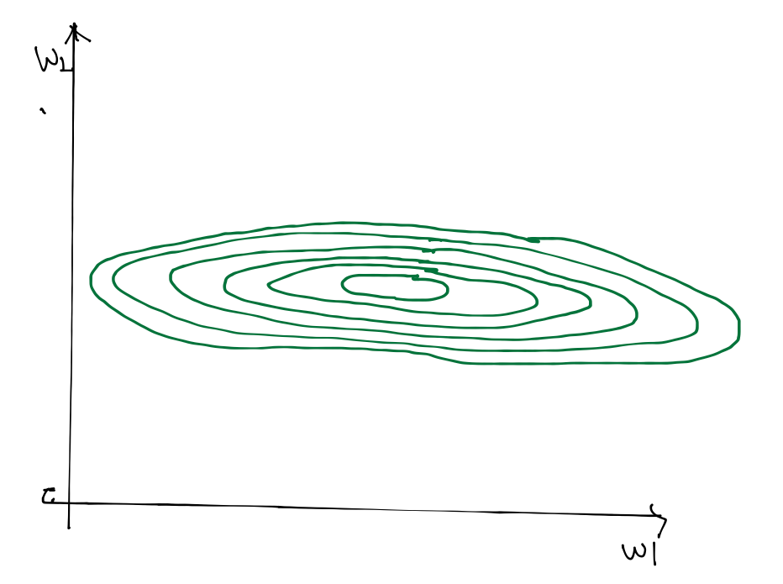
Data (X) preprocessing for gradient descent
x1 | x2 | y
1 | 9000 | A
2 | -5000 | A
4 | -2000 | B
6 | 8000 | B
9 | 9000 | C
Notes:
X1,X2 스케일의 차이로 찌그러진 등고선이 나타남

Slide 9
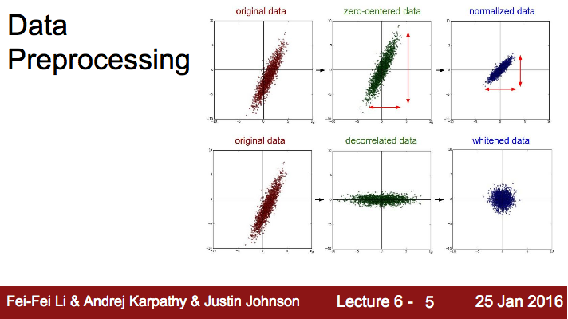
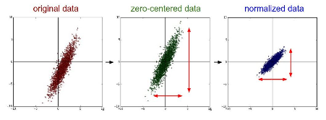
Data (X) preprocessing for gradient descent
Notes:
데이터를 Normalize 시켜줘야 됨

Slide 10

Standardization
http://sebastianraschka.com/Articles/2015_singlelayer_neurons.html
Notes:
이런 형태로 간단하게 Normalization 할 수 있음

Slide 11
Overfitting
Our model is very good with training data set (with memorization)
Not good at test dataset or in real use
Notes:
머신러닝의 가장 큰 문제. 학습 데이터에만 잘 맞음

Slide 12
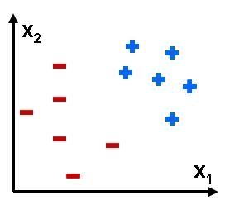

Overfitting
overfitting
Notes:
1번이 더 잘 맞는 모델

Slide 13
Solutions for overfitting
More training data!
Reduce the number of features
Regularization

Slide 14
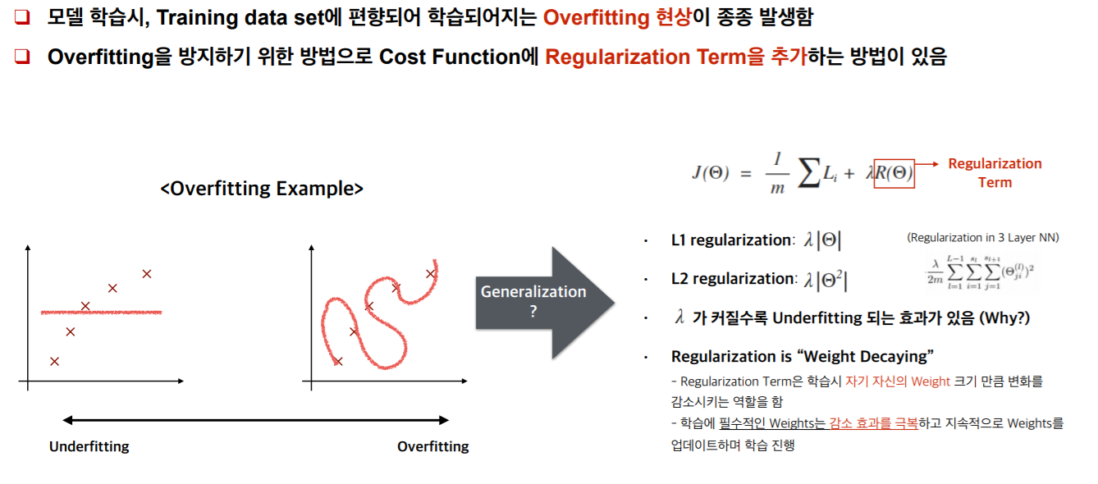

Slide 15
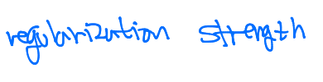
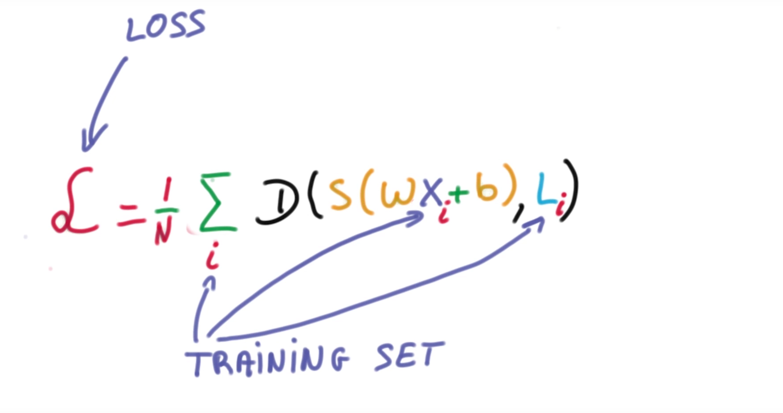
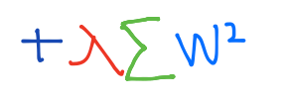
Regularization
Let’s not have too big numbers in the weight
Notes:
구분선을 너무 구부리지 말고 좀 펴자

Slide 16
Regularization
Let’s not have too big numbers in the weight

Slide 17
Summary
Learning rate
Data preprocessing
Overfitting
More training data
Regularization

Slide 18
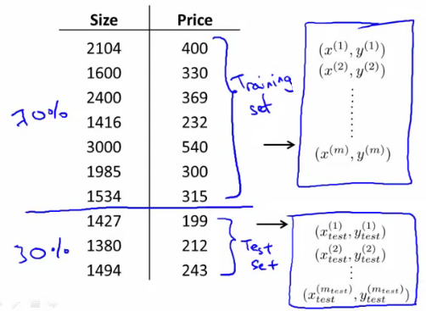
Evaluation using training set?
100% correct (accuracy)
Can memorize
Notes:
모의고사를 다 외워버리면 됨

Slide 19
Training and test sets
ㅇㅇㅇㅇㅇ
Training sets
Test sets
Notes:
실제 시험을 통해 모델을 검증해야됨
Test sets은 숨겨져 있어야됨

Slide 20
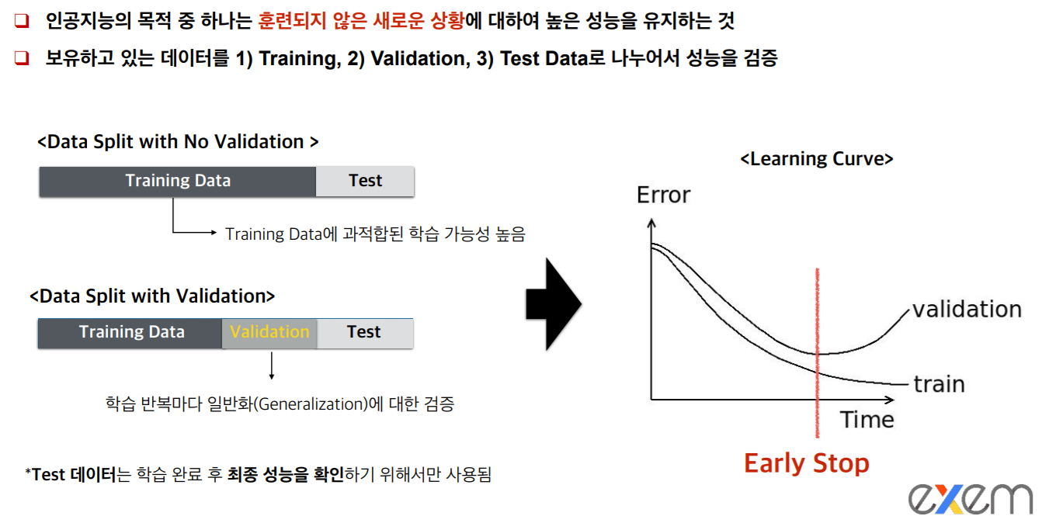

Slide 21

Online learning
Data set
10 만개
model
100 만개
Notes:
10만개씩 잘라서 학습 시킴
새로 데이터가 추가 됬을 때, 전부 다시 학습할 필요 없이 추가 된 데이터만 학습하면 됨

Slide 22
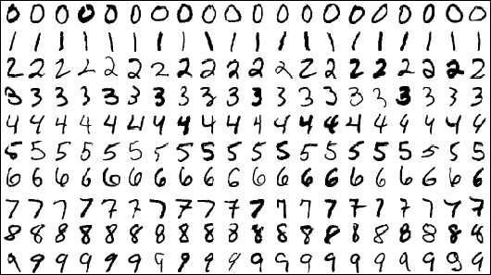
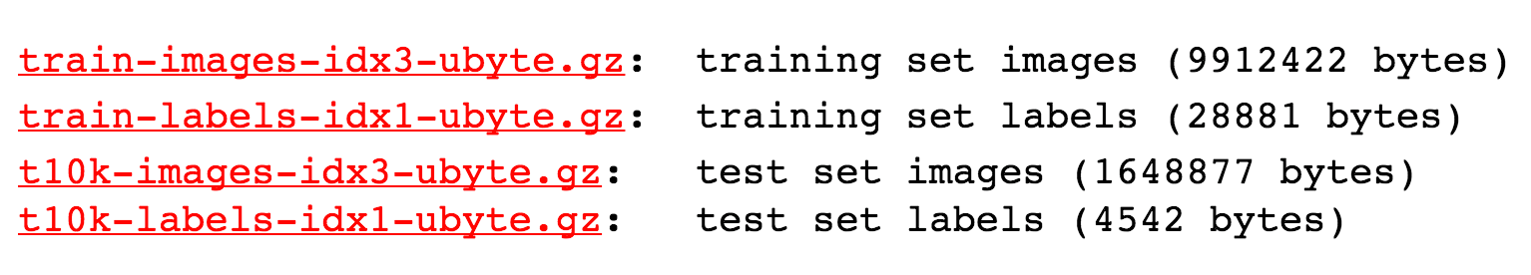
MNIST Dataset
http://yann.lecun.com/exdb/mnist/

Slide 23
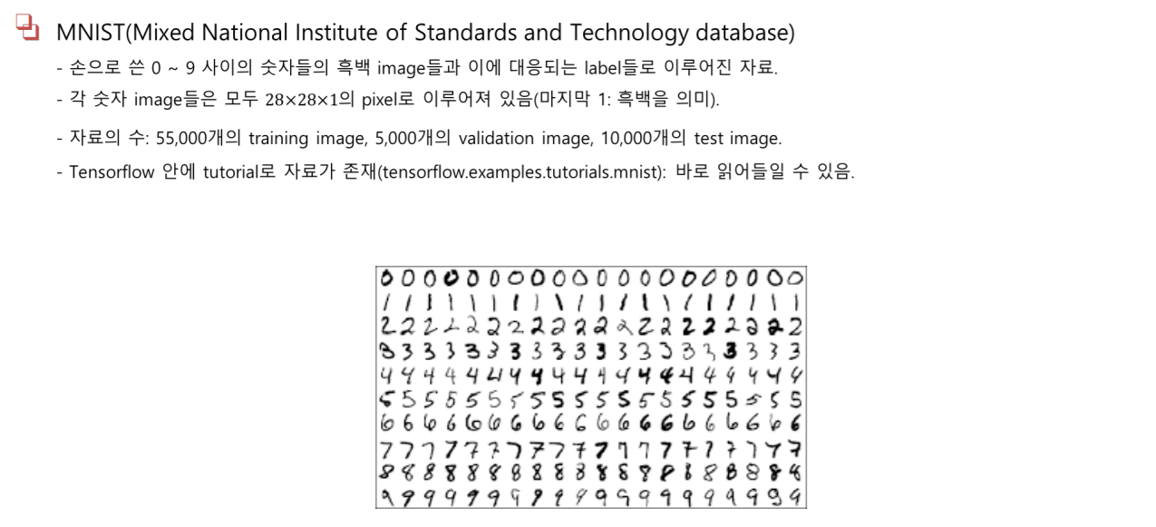

Slide 24

Accuracy
How many of your predictions are correct?
95% ~ 99%?

